Slide 1
Networking - 2
Len Bass
Notes:
This is the slide title. The title of the lecture topic goes in:
<Lecture Title Here>
The lecturer should put their name in:
<Presenter’s Name Here>

Slide 2
Overview
Load Balancer
State
Secure Shell (SSH)
© Len Bass 2015

Slide 3
Load Balancer
One server may not suffice for all of the requests for a given service.
  Have multiple servers supplying the same service.
  Use “load balancer” to distribute requests.
Server registers with load balancer upon initialization
Load balancer monitors health of servers and knows which ones are healthy.
Load balancer ip is returned from DNS server when client requests URL of service.
© Len Bass 2015

Slide 4






Message sequence – client makes a request
Clients
Load Balancer
Servers

Slide 5


Message sequence- request arrives at load balancer
Clients
Load Balancer
Servers

Slide 6

Message sequence – request is send to one server
Clients
Load Balancer
Servers

Slide 7

Message sequence – reply goes directly back to sender
Clients
Load Balancer
Servers

Slide 8
Note IP manipulation
Server always sends message back to what it thinks is the sender.
Load balancer changes destination IP but not the source. Then reply goes directly back to client
Load balancer (now acting as a proxy) can change origin as well. In this case, reply goes back to load balancer which must change destination (of reply) back to original client.
© Len Bass 2015

Slide 9
Routing algorithms
Load balancers use variety of algorithms to choose instance for message
  Round robin. Rotate requests evenly
  Weighted round robin. Rotate requests according to some weighting.
  Hashing – IP address of source to determine instance. Means that a request from a particular client always sent to same instance as long as it is still in service.
Note that these algorithms do not require knowledge of an instance’s load.

Slide 10

Suppose Load Balancer
Becomes Overloaded
– Load Balance the Load Balancers

Slide 11


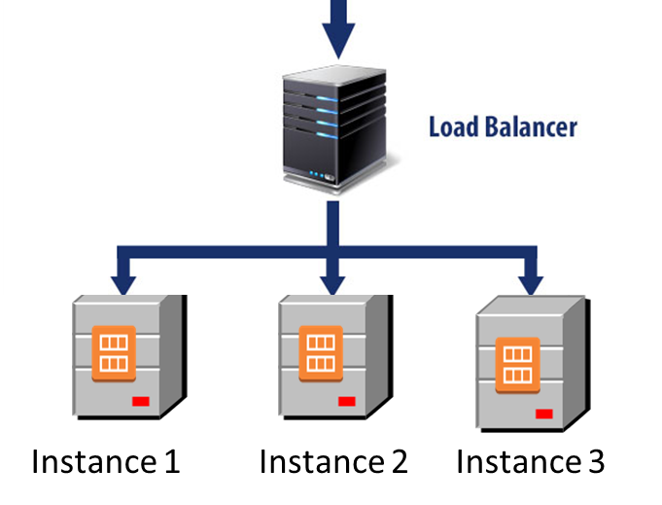
Combining pictures
IP payload address is modified multiple times before message gets to server
Return message from instance to client may go through the gateway (proxy) or may go directly back to the client.
Client
Cloud gateway
copyright 2015 Len Bass

Slide 12
Suppose client becomes overloaded
As load grows, existing resources may not be sufficient.
Autoscaling is a mechanism for creating new instances of a server.
Set up a collection of rules that determine
  Under what conditions are new servers added
  Under what conditions are servers deleted
© Len Bass 2015

Slide 13
First there were three servers
Load Balancer
Servers

Slide 14
Now there are four
Issues:
What makes the decision to add a new server?
How does the new server get loaded with software?
How does the load balancer know about the new server?

Slide 15
Making the decision
Monitor
Each server reports its CPU usage to the monitor
Monitor has a collection of rules to determine whether to add new server. E.g. one server is over 80% utilization for 15 minutes

Slide 16

Loading the new server with software
Configuration specifications
When a new instance is created, it is created based on a launch configuration, security groups, etc

Slide 17
Making the load balancer new server aware
The new server registers with a load balancer.
It is told which load balancer during instantiation by the monitor

Slide 18
Overview
Load Balancer
State
Secure Shell (SSH)
© Len Bass 2015

Slide 19
Types of State
Session state
Client side state
Server side
Persistent

Slide 20
What is a session?
A session typically refers to a series of interactions between one client login to a system and the termination of that login – whether through logging out or through timing out.
A session can also span multiple logins. E.g. Netflix keeps track of where you are in a movie and returns you to that location the next time you log in.

Slide 21
Session State
Session state is information that persists for a session. We are considering a single login here. The multiple login case is a special case of persistent state.
What happens when you login
  When you successfully login to a service, the service returns a code that identifies you. This is the session ID.
  Other information can also be included such as MAC address (to prevent man in the middle attacks).
  It is typically managed on the client side. Your browser does all of this.

Slide 22
Client Side State
If state is saved on the client side then
  The client passes all of necessary state with each request
  This requires more network overhead
This also means data is stored on the client machine
  This can have security implications

Slide 23
Stateful Services
If your services are stateful that makes scalability more difficult
If you’re able to design your system such that the services are stateless you’ll make scaling much easier
If an operation is dependent on the results of a previous operation it’s more difficult to make services stateless

Slide 24
Management of state between services and persistent tier
Non client side state can be either kept in the services or in a persistent store.
The choice depends on the volume of data, the latency involved, the synchronization needs for the servers and the time the state is expected to persist.

Slide 25
Important latency numbers
Main memory reference 100 ns
Send 1K bytes over 1 Gbps network 0.01 ms
Read 4K randomly from SSD. 15 ms
Read 1 MB sequentially from memory 0.25 ms
Round trip within same datacenter 0.5 ms
Read 1 MB sequentially from SSD 1 ms
(4X memory)
Disk seek 10 ms
(20x datacenter roundtrip)
Read 1 MB sequentially from disk 20 ms
(80x memory, 20X SSD)
Send packet CA->Netherlands->CA 150 ms
* dean-keynote-ladis2009_scalable_distributed_google_system

Slide 26
Implications of latency numbers
State stored in persistent storage (disk or SSD) will take longer to fetch than state stored in memory.
State stored in a different datacenter will take longer to access than state stored locally, especially across continents.
Persistent store is typically replicated both for performance (latency) reasons and for availability (failure) reasons.
=> keeping data consistent across different occurrences of it is important but difficult. We return to tools to manage consistency in a later lecture.

Slide 27
Overview
Load Balancer
State
Secure Shell (SSH)
© Len Bass 2015

Slide 28
SSH
Secure Shell (SSH) is a standard protocol and supporting software that enables the control of one computer remotely from another
SSH has a concept of “known addresses” that allows loging into remote computer without a password.
SSH is used by tools to provision and manage collections of computers.
It is based on the Diffie-Hellman algorithm
© Len Bass 2015

Slide 29
Diffie-Hellman
Diffie-Hellman is a basic algorithm that enables public disclosure of most of the elements of an encryption scheme with only the P/NP decoding assumption.
It provides a method for generating a shared secret, s, between two people over an open channel.
This is taken from Crypto 101 pp95-96
© Len Bass 2015

Slide 30
Basic assumption
p is a large prime
g is a base such that g^{p} = 0 (mod p)
Computing y = g^{x} (mod p) is easy but finding x when given y, g, and p is NP difficult.
So y, g, and p can all be made public without compromising the ability to find x.
© Len Bass 2015

Slide 31
Using basic assumption
Alice (or Bob) select p and g from the basic assumption. These are publically shared.
Alice and Bob each select random numbers r_{A} and r_{B.} They keep them secret (even from each other)
Alice computes m_{A} = g^{rA} (mod p) and sends it to Bob
Bob computes m_{B} = g^{rB} (mod p) and sends it to Alice
Bob computes s = (g^{rA})^{rB} (mod p). I.e. m_{A} raised to his secret number. Alice does a similar computation. Because exponents are commutative (x^{AB} = x^{BA}) they both arrive at the same s but an eavesdropper cannot derive s. Furthermore, r_{A} and r_{B} are kept secret.
© Len Bass 2015

Slide 32
SSH protocol
Machine A and Machine B use Diffie Hoffman to establish secure connection.
Then secure connection is used to share a one time password between Machine A and Machine B.
This one time password lives for the life of the session and is more efficient that a public/private key pair.
© Len Bass 2015

Slide 33
Summary
Load balancers manage multiple servers for a single service.
How state is managed has impacts on scalability, reliability, and performance.
SSH is standard technique for controlling remote computers.
Scaling is a matter of adding or deleting resources
© Len Bass 2015

